Slide 1
#exed
Creators: Joe Kozlowski, Kate McCluskey, and John Leverett

Slide 2
Agenda
Introduction
Concept
Motivation
Design Process
Technologies
Demonstration
Future
Questions

Slide 3
Introduction
The Team
Kate McCluskey: Front End Lead
Joe Kozlowski: Back End Lead
John Leverett: Research

Slide 4
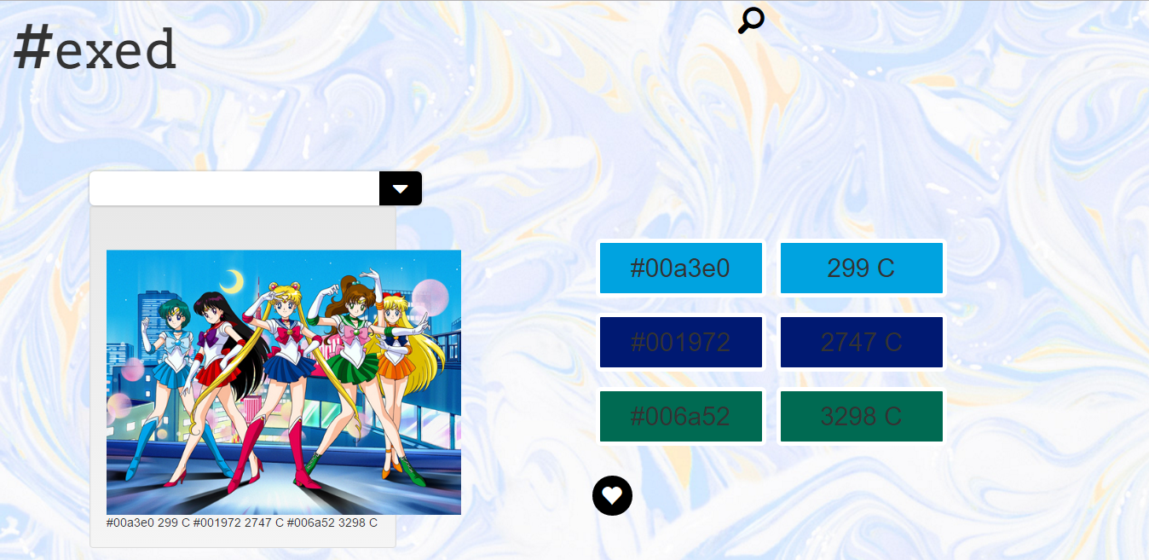
Concept
Paste an image with an unknown color(s) into application and #exed will tell you both the Hex code and Pantone for the top 3 colors that appear in that image

Slide 5
Motivation
Graphic Design
Real world colors
Inability to use what you see

Slide 6
Design Process
Front End
WW3 Schools, CodePen
Back End
Mashape

Slide 7
Technology
APIs
Google Custom Search
Impalette
Email JS
New Technology
Frameworks: Skeleton

Slide 8
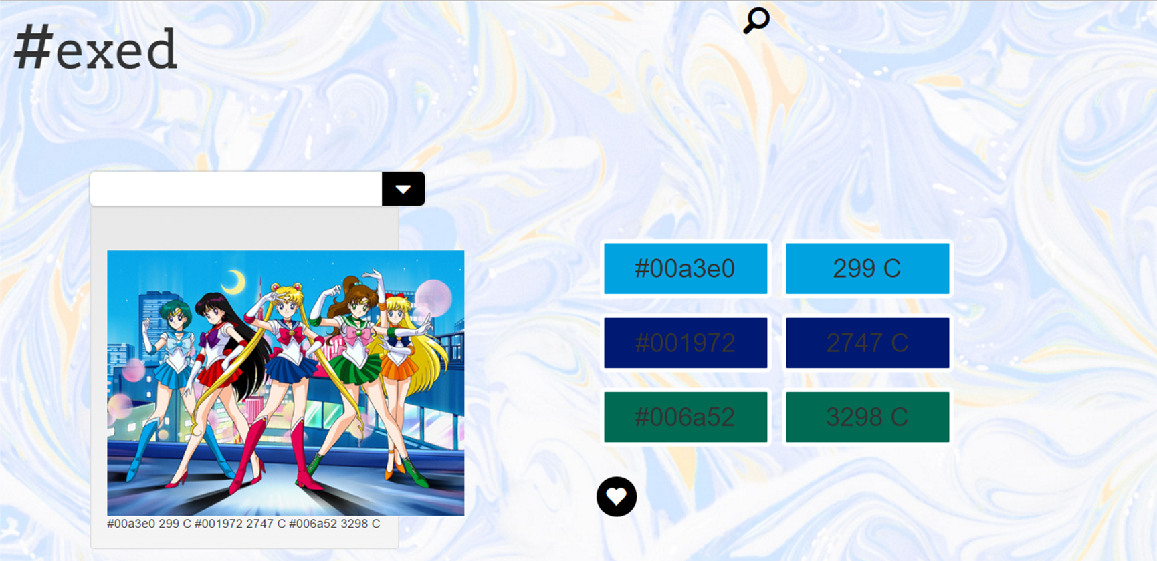
Demo

Slide 9
https://am22.akamaized.net/tms/cnt/uploads/2014/05/Happy_sailor_moon.gif

Slide 10
Future
Mobile
Take a pic with your phone in real time
User support
Login
Stored searches, YourPalette, Favorite Colors
Share function
Finished projects with #exed colors shared on social media
Most popular colors #exed
Indentify trends: marketable to fashion designers and web developers, corporations wishing to style products based on colors presently popular
Develop as an add on to other programs
Mouse over the exact color that you’d like to have the Hex/Pantone

Slide 11
Questions

